Slide 1
35th Anniversary

Slide 2
Welcome to the 2024 Fall Conference 2024 marks the 35th Anniversary of The Ohio Association of Magistrates
In the Spring and Summer of 1989 several referees(NKA Magistrates) convened to organize an association dedicated to the advancement and education of Magistrates.
On September 23, 1989, the first state-wide meeting was conducted in Columbus with 67 members present.
The following goals were adopted: To increase membership, establish a newsletter; create credibility for referees and the association and improve education.

Slide 3
CHARTER MEMBERS of the OAM
John Adams
Thomas Bean
Mabel Becker
Joseph Bertone
Sally Boyd
Richard Cheney
Charles Cochran
Ernest Cottrell
Penelope Cunningham
Carl Dornshuld
Richard Eisnaugle
Nancy Ferguson
Lanette Flower
Margaret Gasper
Donald Gehlmann
Benjamin Goodman
Kathleen Graham
Richard Graham
John Hall
James Henderson
Pamela Holmes
Mark Huberman
Donald Icsman
Garlandine Jones
Ronald Kaufamn
Stuart Kelly
Eva Kessler
Dennis Kimball
George Kodak
Jefferson Liston
Mary McElwee
Beverly Moffet
Jeffery Nelson
Barbara Norton
Dennis Parish
Barbara Porzio
Thomas Short
Wayne Strunk

Slide 4
OAM Education Award Recipients The following individuals have been granted the OAM Education Award in recognition of their extraordinary contributions to the education of Ohio’s Judiciary
Sandra Lewis – 2019
Judy Fornoff – 2018
Mike Finney – 2017
Serpil Ergun – 2016
Barbara Norton – 2015
James Aylward – 2014
Richard Altman – 2013
Lora Lynn Stalnaker – 2012
Patti Reed – 2011
Coleen Dailey – 2010
Kate Graham – 2009
Milt Nuzum – 2008
Ann Weatherhead – 2007
Bill Rickrich – 2006
Barbara Porzio – 2005
Brian Goodell – 2004
Christy Tull – 2003
Diane Palos – 2002
Phil Schopick – 2001
Doug Sendry – 2000
Mary McElwee – 1999
Dennis Parish - 1998
Martha Kilbourn - 1997
Michael Bernstein - 1997

Slide 5
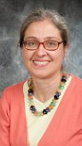
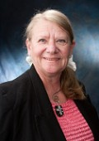
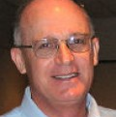
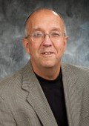
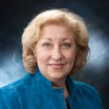
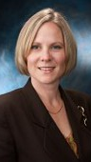
Education Award Winners

Slide 6
2009 BOARD

Slide 7
OAM JUDICIAL AWARD The Award recognizes Magistrates who have been members of the OAM who have gone on to become Judge
Michael McCallister Carol Ann Robb Jonathan Starn Eva Kessler
Susan Baker Ross Christopher Roberts Kathleen Roman Dennis Greeney
Natalie Haupt David Hejmanowski Glen Derryberry Matt McFarland
Linda Warner Kenneth Spicer Bruce Winters Dennis Parish
Carla Baldwin Scott Washam Diane Palos
Ron Cable Carl Henderson Beth Root
Nicole Walker Dan Bratka Carol Dezso
Anthony D’Apolito Jim James Denise McColley
Penelope Cunningham Linda Teodosio Timothy O’Connell
Tonya Jones Barbara Schneider Thomas O’Malley
Cynthia Morehart Kathleen Rodenberg Richard Bernat
Mark Hummer Robert Fragale Steve Hurley
Michelle Paris Laura Gallagher Charles Pater

Slide 8
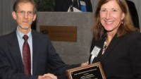
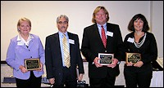
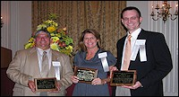
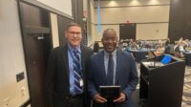
JUDICAL AWARD WINNERS

Slide 9
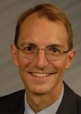
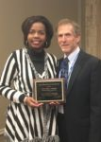
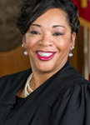
JUDICIAL AWARD WINNERS

Slide 10
2 0 1 4
OAM
BOARD

Slide 11
LIFE MEMBERS The OAM Board of Trustees has bestowed the Association’s highest honor on individuals whose contributions to the Board and the Association have gone above and beyond the call of duty!
Pam Heringhaus William Byrne
Chief Justice Maureen O’Conner Carol Hargreaves
Bill Rickrich Beverly Moffett
David Jump Doug Sendry
Roseanne Hilow Dennis Parish
Mark Huberman Tom Bamburowski
Kate Graham Karen Harvey
Alan Carter Bill Melvin
Carol Dezso Barbara Norton
Diane Palos J. Michael Berstein
Beth Root

Slide 12
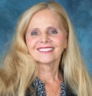
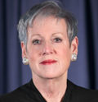
Life Members
Bill Rickrich
Pam Heringhaus
Chief Justice
Maureen O’Conner

Slide 13
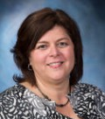
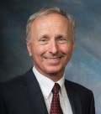
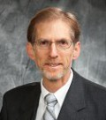
Life Members
Roseanne Hilow
David Jump
Mark Huberman

Slide 14
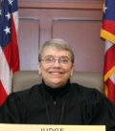
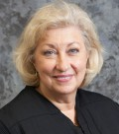
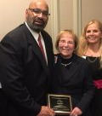
Life Members
Carol Dezso
Kate Graham
Alan Carter

Slide 15
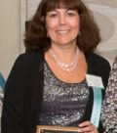
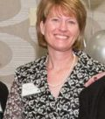
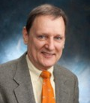
Life Members
Diane Palos
Beth Root
William Byrne

Slide 16
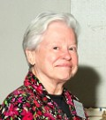
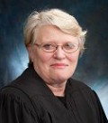
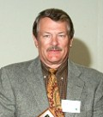
Life Members
Beverly Moffett
Carol Hargreaves
Doug Sendry

Slide 17
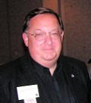
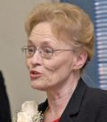
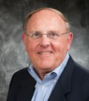
Life Members
Dennis Parish
Karen Harvey
Thomas Bamburowski

Slide 18
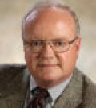
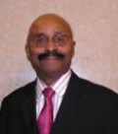
Life Members
J. Michael Bernstein
Barbara Norton
William Melvin

Slide 19
The Board of Trustees have bestowed Honorary Memberships upon non-members in recognition of their extraordinary contributions to the role of Magistrates in the State of Ohio
Sandy Clary Patricia Maiorino
Lindsey Schmitz Anne McNealy
Katrina Webb Nancy Ferguson
Kathleen Casper Richard Eisnaugle
Philip Schopick Michael Merz
Wayne Strunk Ann Hamilton
Lawrence Smith Chief Justice Thomas Moyer
Steven Stover Jeff Liston
Honorary Members

Slide 20
2019 OAM BOARD

Slide 21
PRESIDENT’S AWARD RECIPIENTS For Magistrates who provide outstanding contributions to the OAM
David Jump
Pamela Heringhaus
Tom Shutt
Kenneth Roll
Ann Weatherhead

Slide 22
COMMUNITY OUTREACH
The introduction of the OAM Community Outreach Program was implemented at the 2010 Spring and Fall Conferences. The OAM offers members an opportunity to participate in a volunteer service project at our conferences.
The OAM is proud to include community outreach opportunities at our conferences as a way for the OAM to give back to our host communities and for our members to make a meaningful contribution to society outside the courtroom.

Slide 23
COMMUNITY OUTREACH BENEFICIARIES throughout the years
Med Wish Westerville Area Resource Ministry Local Matters
Mid Ohio Foodbank Columbus Dress for Success Good Neighbor House
Vail Meadows Girls on the Run-Central Ohio Columbus Diaper Bank
Waters Edge Community Center Kinkaid’s Kindred Spirits Crossroads
Worthington Thrift Shop Habitat for Humanity Red Cross
Clothes that Work PBJ Connections
Worthington Food Pantry Geauga County CASA
Lake Metropark Fisher House
Chill Youth Hockey Assoc. Dolly Parton Imagination Library
Ohiocan Columbus Parks Olentangy Trail
People in Need Community Cup Classic Foundation
UpSpring A Kid Again

Slide 24
DEDICATED MAGISTRATES
For the 35th Anniversary the Association would like to recognize Magistrates that have served the profession and judiciary honorably throughout their careers. Following is a list of Magistrates with 15 or more years of service.

Slide 25
40+ YEARS OF SERVICE
Jane Martin-44
Gregory Theile-40
David Duren-40

Slide 26
35+ YEARS OF SERVICE
Serpil Ergun-37
Scott Bombeck-37
Hedi Koenig-36
John Bruewer-36
Alexander Savakis-36
Mary Schulcz-35

Slide 27
30+ YEARS OF SERVICE
Edward Fink-34 Deborah Drexler-31
Pamela Browning-34 John Kolberg-31
Bennett Manning-34 Sharon Dennis-31
Richard Boucher-34 Kathryn Boller-Koch-31
Andrew Art-34 Kevin Augustyn-30
Myron Harkacz-34 Antonio Paat Jr.-30
Carl William Rickrich II-33

Slide 28
25+ YEARS OF SERVICE
Sherry Pidala-29 Lorenzo Sanchez-28
William Stearns-29 Laura Restivo-28
Rogena Stagel-29 Barbara Petersen-27
Woodrow Hudson-29 James Morgan-27
Alan Mutchler-29 Richard Machuga-27
Thomas Stone-29 Terrence Butler-27
Elaine Stoermer-29 Cynthia Williams-27
Ellen Marie Leonetti-29 Alan Michalak-26
Patricia Wilkerson-29 John Armin Blaufuss-26
Robert Kelsey-28 Susan Sugar-26
Penny Gates-28 Trevor Fernandes-26
Scheherazade Washington-28 Stephen Bucha-26

Slide 29
25+ YEARS OF SERVICE CONTINUED
Terrence Kapp-26
Katherine Severt -26
Richard Schwartz-26
Joseph Dowling-26
Terrie Clinger-25
Susan Williams-25
Bradley Sales-25
Kendal Coes-25
John Clark-25
Eileen Gerity-25
Nancy Miller-25
Peter Murray-25

Slide 30
20+ YEARS OF SERVICE
Jonathan Perrin-24 Nancy Ann Novack-24
Jeffrey Short-24 Dennis Kerber-24
Joseph Gallagher-24 Mark Majer-24
Kevin Pelanda-24 Thomas Dawson-23
Dwaine Hemphill-24 Stephan Collins-23
Sandra Miller-24 Linda Leggett-23
Edwin Skeens-24 Kelli Rice-23
Myra Embry-24 Brenda Anthony-23
Sharon Robinson-Walls-24 Paul Lucas-23
Lynn McLaughlin Murray-24 Patrick Phillips-23
Melissa West-Koistila-24 Edward Kurek-22
Elizabeth Howe-24 Louis Endres-22

Slide 31
20+ YEARS OF SERVICE CONTINUED
Mark Reed-22 Lori Flowers-22
Quinton Dressel-22 Benjamin Suffron-22
Kimberly Combs-22 Van Lowry-22
Scott Kitson-22 Harold Matthew Reed-22
Paul Rattermann-22 James O’Leary-21
Gary Schaengold-22 Nicholas Sylvain-21
Kathryn Maxine Hanson-22 Barbara Reno-21
Rebecca Hall-22 Rita Rochford -21
Michael Masterson-22 Lynne Yohe-21
Edith Jonas-22 Helen Rowlands-21
Donald DeSanto-22 Rebecca Heimbaugh-21
Gerard Kovacik-22 Marcia Hollins-21

Slide 32
20+ YEARS OF SERVICE CONTINUED
David Reed-21 Julie King-20
John Shorts-21 Andrea Burns-Smith-20
Wendy Jo Smither-21 Kathleen Lenski-20
Olga Milliken-21 Timothy Welsh-20
Holley Madigan-21 Monica Klein-20
Gregory Thomas -21 Lisa Obert-20
Heidi Petruska-21
Carolyn Duvelius-21
Douglas Hoover-21
Robert Peelle-20
Myron Thompson-20
Paula Durden-20

Slide 33
15+ YEARS OF SERVICE
Jeffrey Black-19 Patrick Kelly-19 Christopher Strefelt-18
Mary Ann Mendlik-19 Sharon Echols-19 Erin Scanlon-18
Edna Jboyle-19 Amy Jackson-19 Stephen Blake-18
Diane Dougherty-19 Mathew Spangler-19 John Dyke-18
Dennis Sarisky-19 Danielle Sparks-19 Timothy Ludick-18
Robert McCarty-19 Rebecca Ligibel-19 Dominic DeLaurentis Jr-18
Priscilla Cunnigham -19 Jacqueline Huntley-19 Mary Ruttan-18
Jeffrey Ehrbar-19 Joseph Pfundstein-18 Jeremy Foltz-18
Christopher Stallkamp-19 Charles Walsh-18 David Lee Kitzler-18
Gregory McGory-19 Todd Calaway-18 John Pico-17
Thomas Freeman-19 Donald Hepfner-18 Brett Plassard-17
Franklin Beni-19 Jeralyn Mercer-18 Stephanie Perazzo-17

Slide 34
15+ YEARS OF SERVICE CONTINUED
Beth Aurilio-17 Steven Bechtel-17 Mary Ann Boone-17
Christopher Day-17 Timothy Clemens-17 Shibani Massacci-17
Karen Melone-17 Justin Lane-17 Mark Petrucci-17
Timothy Roston-17 Jeffrey Slyman-18 Gregory Miller-17
Karen Falter-16 James Lyle-16 Melinda Reardon-16
Karen Cannon-16 John McCracken-16 Darya Klammer-16
Linda Butler-16 Jeffrey Giuliano-16 Mattie Klein-16
Derek McClowry-16 Joseph Armanini-16 Michelle Pena-16
Jimmy Jackson Jr-16 Tamela Womack-15 Melinda Bradford-16
Kirk Lindsay-16 Fredrick Audi-16 Karen Shilling-16
Diana L Songer-15 Robert Moore-15 Amy Busic-15
Amanda Kuhn-15 Janette Bell-15 Eleanore Hilow-15

Slide 35
15+ YEARS OF SERVICE CONTINUED
Jodi Walllace-15
Costa Mastros-15
Kari Childs-15
Stephanie Gibson-15
Donald Bennett-15
Gretchen Stocker-15
Thomas Walser-15
Ghada Halasa-15
Marie Rady-15
Donald Lee McWhorter-15
Kandi O’Connor-15
Jennifer Svec-15

